Slide 1
Best Practices in Phylogenetic Comparative Analyses
EQGW 2025

Slide 2
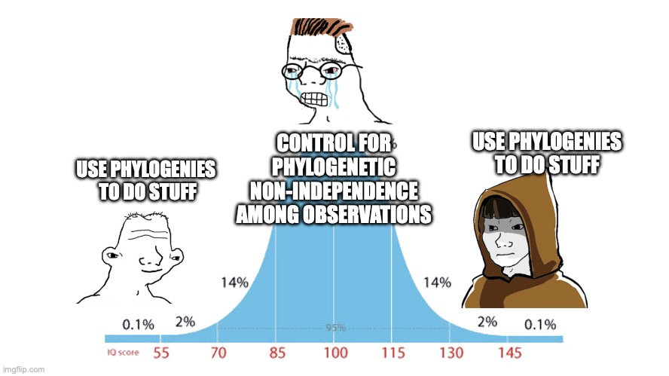
Phylogenetic comparative methods

Slide 3

interpretation
Models
“Estimated data”
(phylogenies)
Data

Slide 4
interpretation
Models
inadequacy
“Estimated data”
(phylogenies)
error/
inadequacy
error
Data

Slide 5
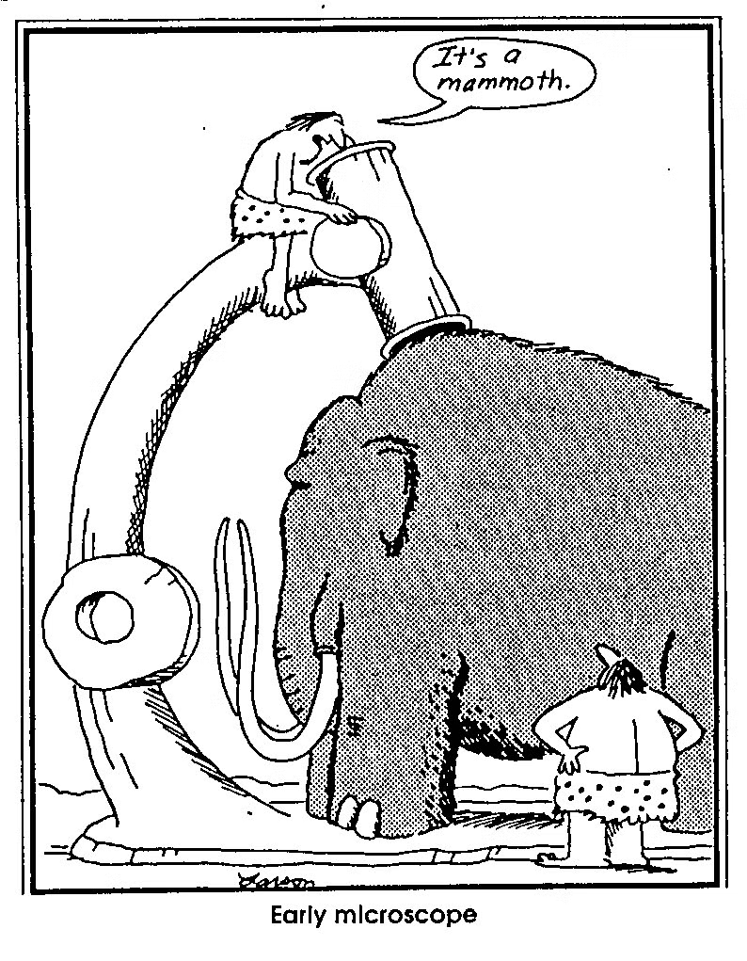
Measurement error
Measurement errors are not perfect (and sometimes we screw up)

Slide 6
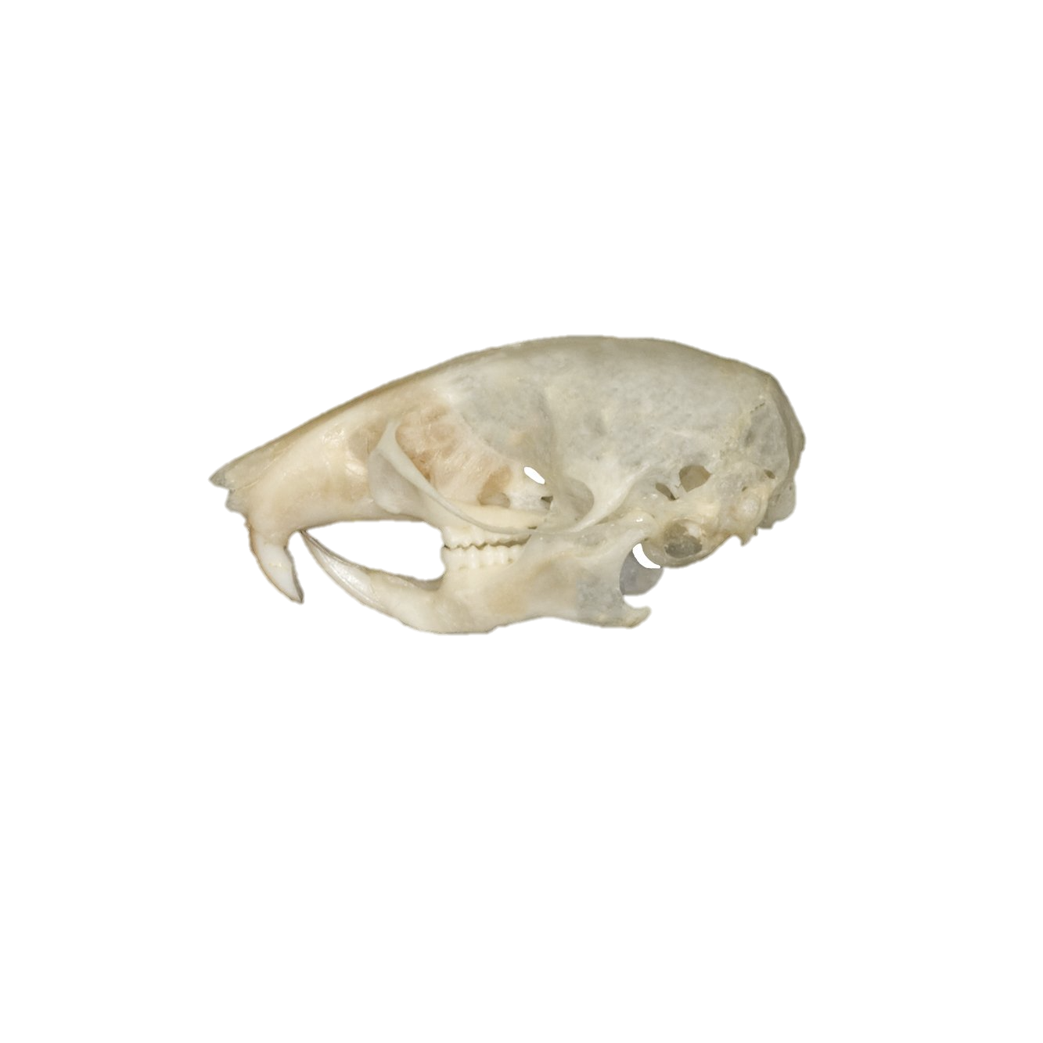
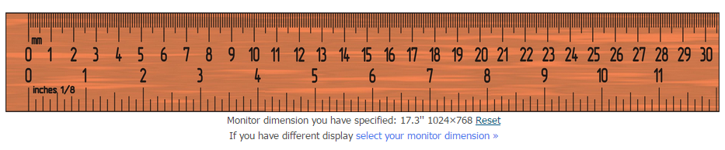
Measurement error
Multiple sources:
Equipment error/imprecision

Slide 7

Measurement error
Multiple sources:
Equipment error/imprecision
Interobserver error

Slide 8
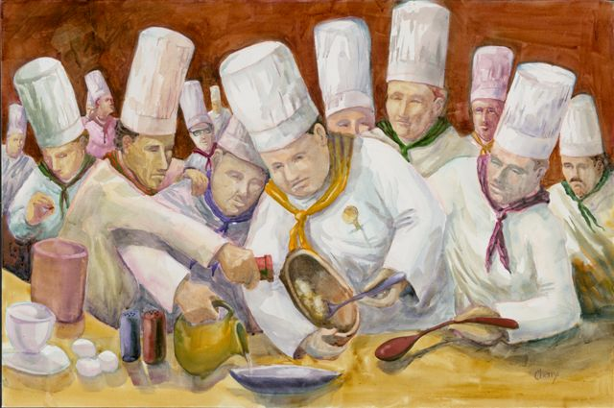
Measurement error
Multiple sources:
Equipment error/imprecision
Interobserver error
Interobserver error

Slide 9


Measurement error
Multiple sources:
Equipment error/imprecision
Interobserver error
Interobserver error
Intraindividual- behavior/physiology
Blocks – treatments
…
etc
Why would it matter in PCM?

Slide 10
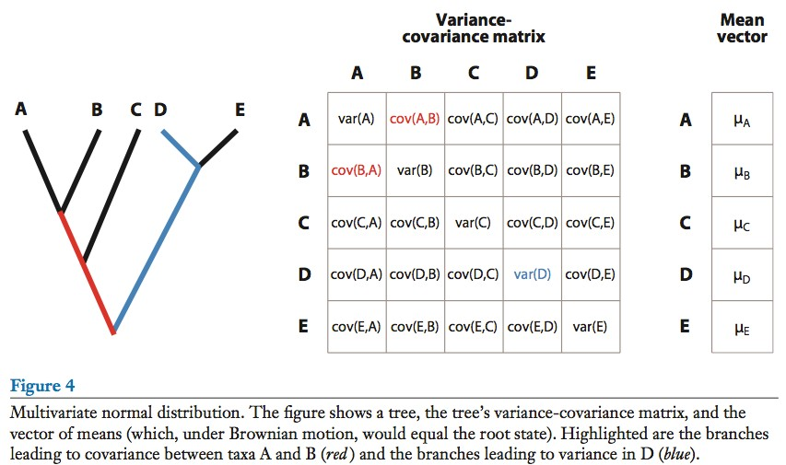
If we have error, this is imprecise
O’Meara 2012

Slide 11
+error
+error
+error
+error
+error
Does in matter in reality?
O’Meara 2012

Slide 12
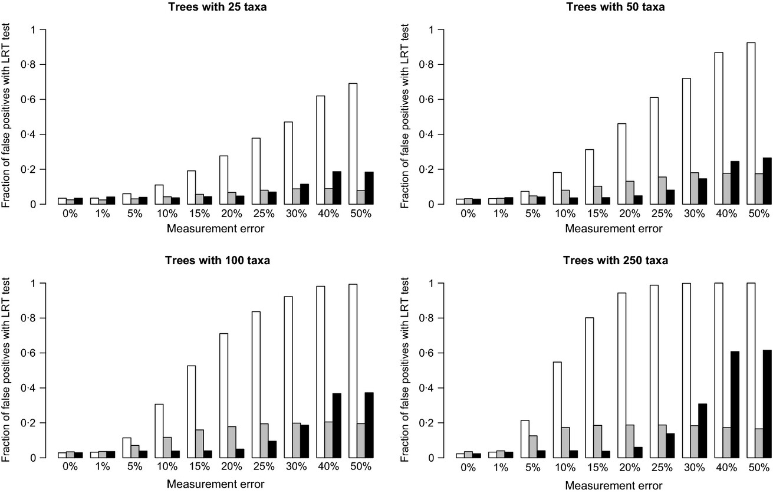
White- ME ignored; Gray- ME estimated; Black- ME known
Silvestro et al 2015

Slide 13
Lessons
Always account for measurement error

Slide 14
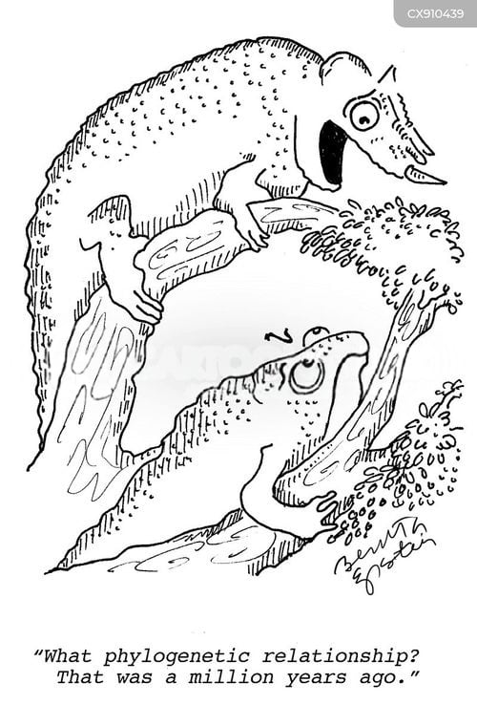
Phylogenetic uncertainty
Phylogenies are estimated, and therefore have errors and uncertainties

Slide 15
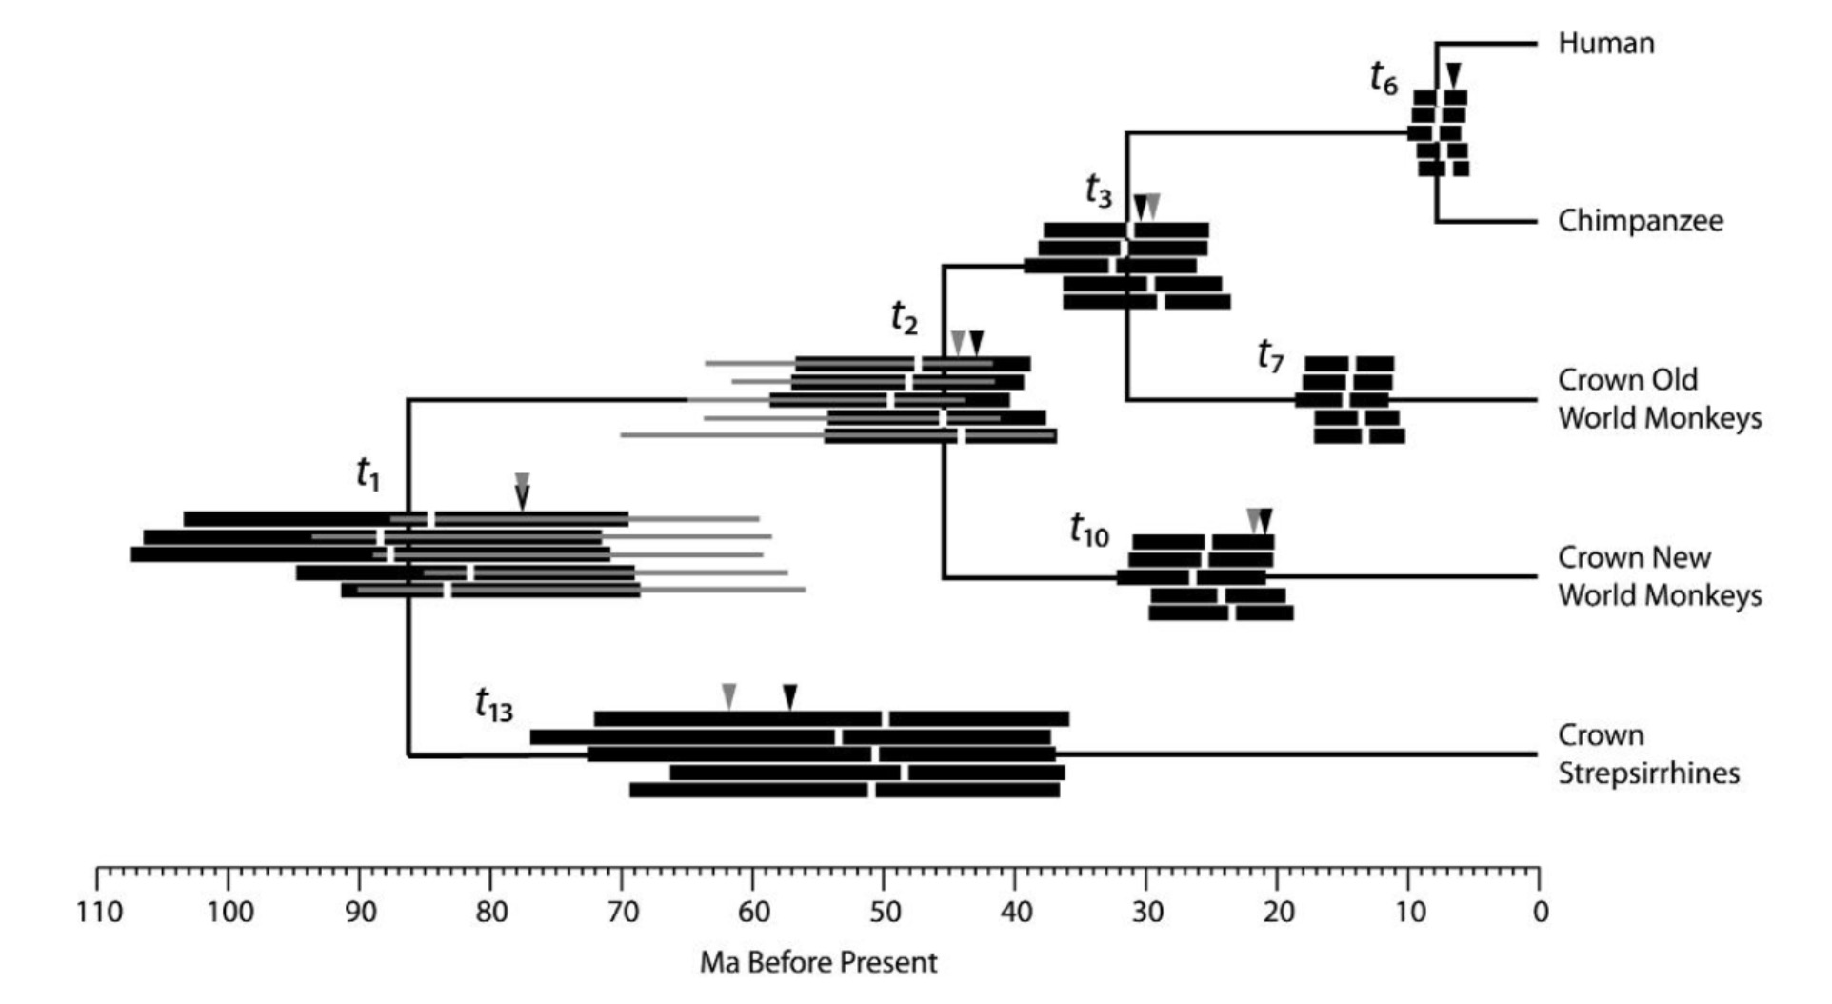

Phylogenetic uncertainty
Age uncertainty
Wilkinson et al. 2011

Slide 16
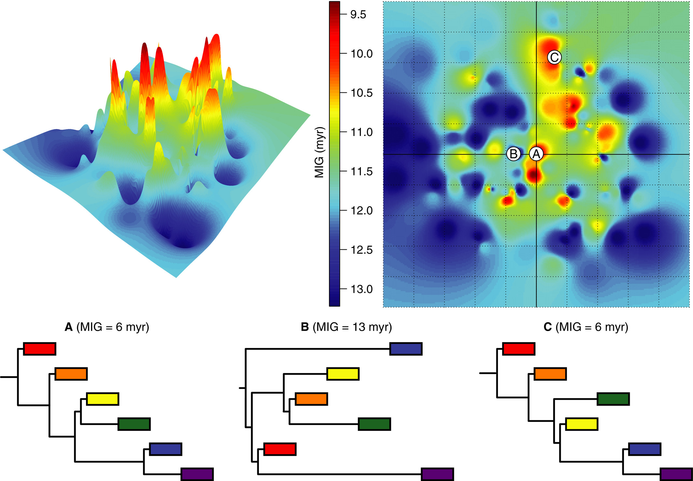
Topological uncertainty
Wright & Loyd, 2020
What can we do?

Slide 17
Rerun analysis with a bunch of trees!
Data
Data
Data
Method
Method
Method
Results
Results
Results

Slide 18
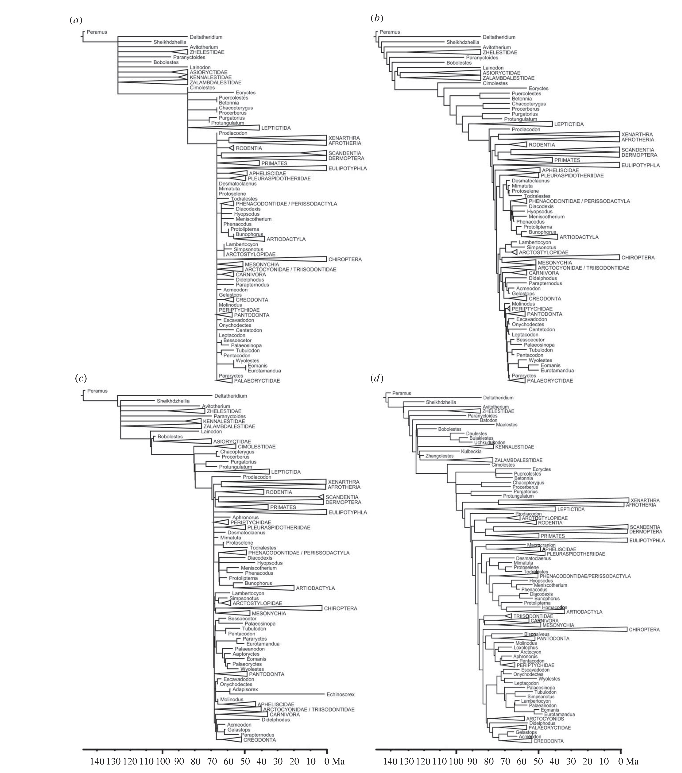
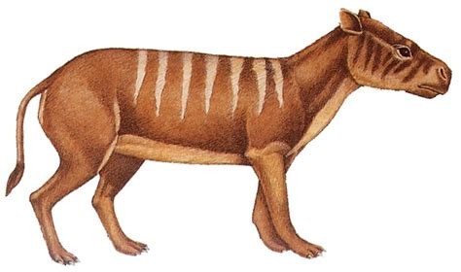
Body mass evolution in fossil mammals
Minimum age dating
Equal branch sharing
Fossilized birth-death
cal3
Halliday & Goswami 2016

Slide 19
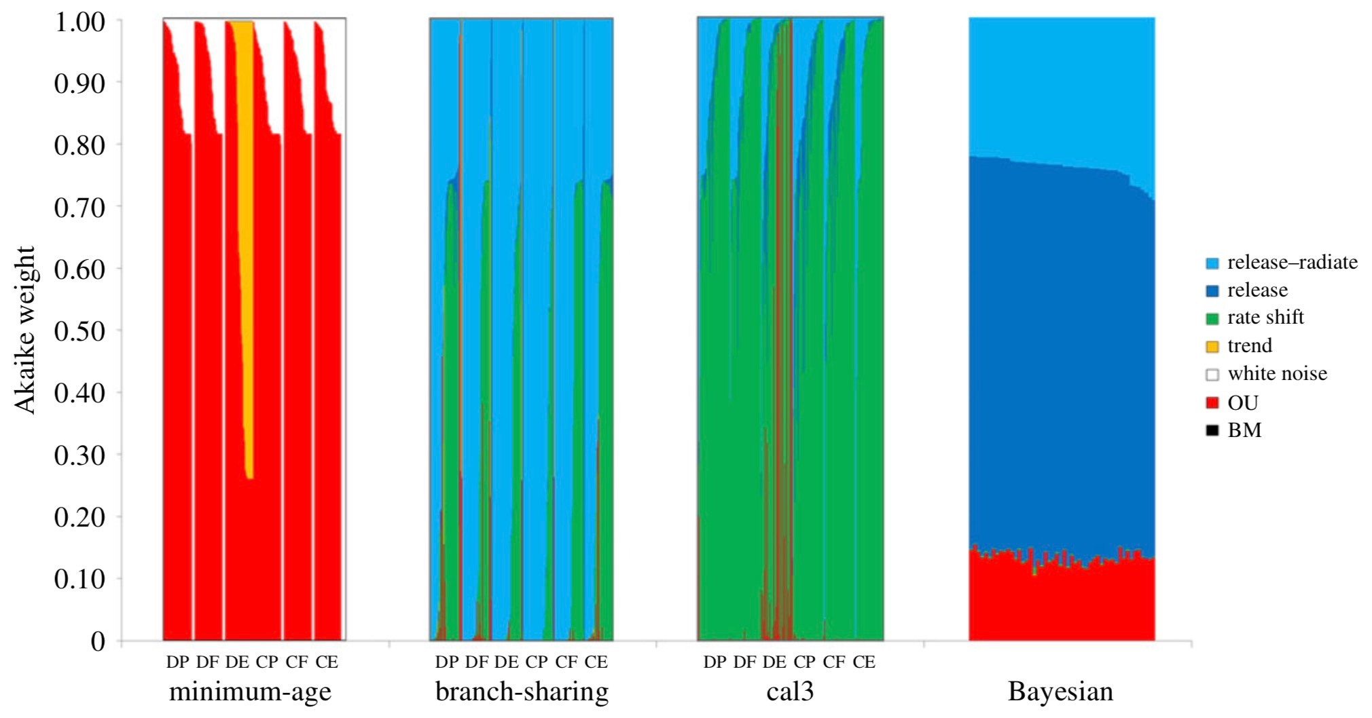
Halliday & Goswami 2016

Slide 20
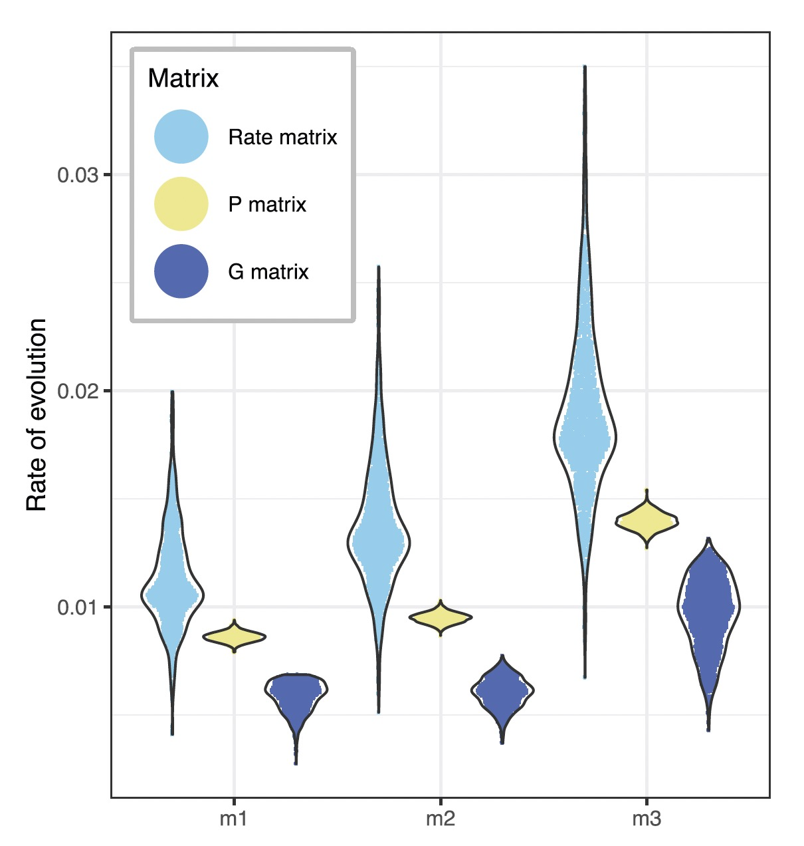

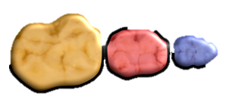
Mongle et al., 2022

Slide 21
Lessons
Always account for measurement error
Always account for phylogenetic uncertainty

Slide 22
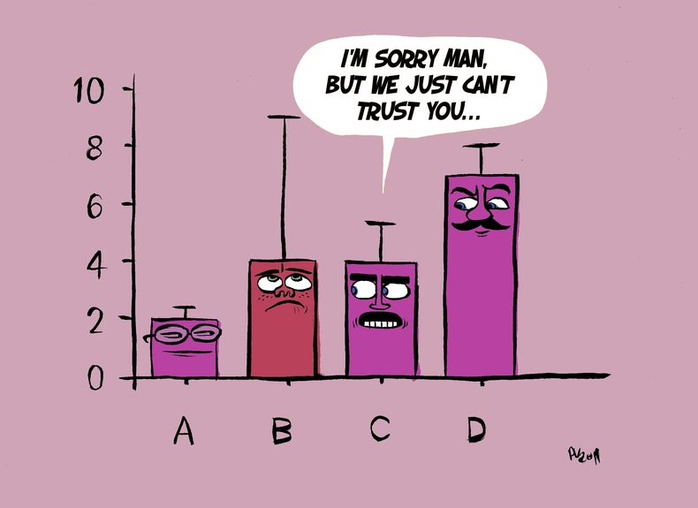
Parameter Estimation error
Model parameters are estimated with error

Slide 23
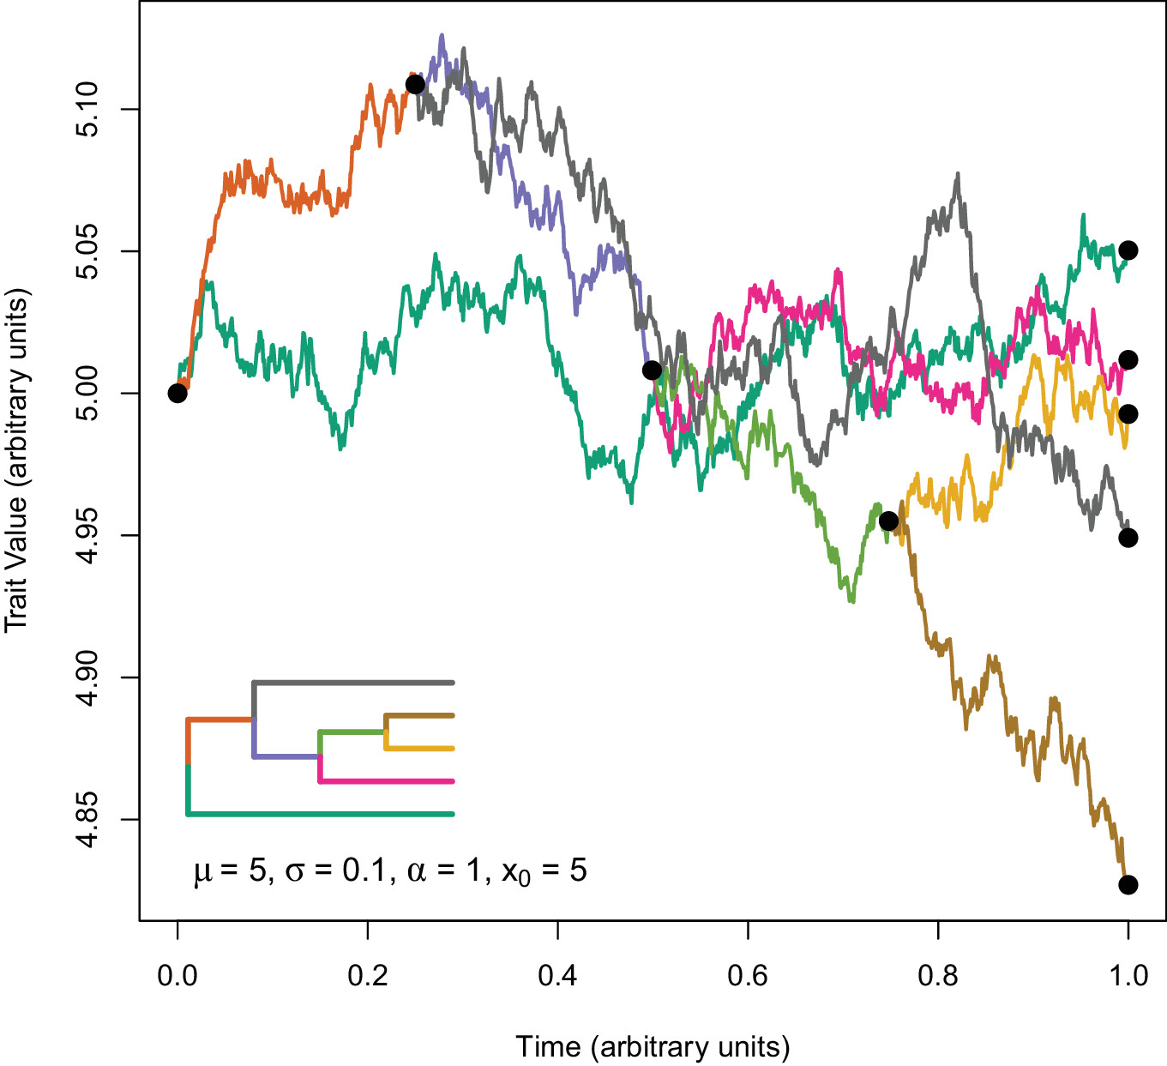

Parameter estimation
$$dy=−α\left(y(t)−θ(t)\right)dt+σdW$$

Slide 24

Parameter estimation
$$dy=−α\left(y(t)−θ(t)\right)dt+σdW$$
Rate of adaptation
Ancestral state y₀
Rate of stochastic evolution
Primary optima
Evolutionary models have evolutionary parameters that must be estimated through data
How is it done?

Slide 25
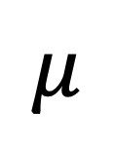
Likelihood
$$μ$$
Density
Z

Slide 26
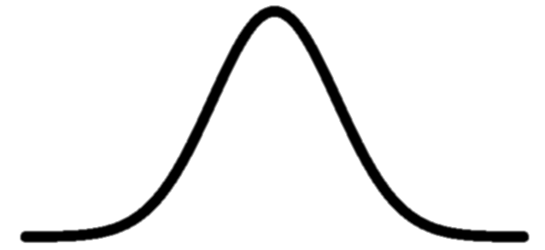
Likelihood
$$μ$$
Density
Z

Slide 27
Likelihood
$$μ$$
Density
Z

Slide 28
Likelihood
$$μ$$
Density
Z

Slide 29
Likelihood
$$μ$$
Density
Z

Slide 30
Likelihood surface
Likelihood
$$μ$$
Density
Z

Slide 31
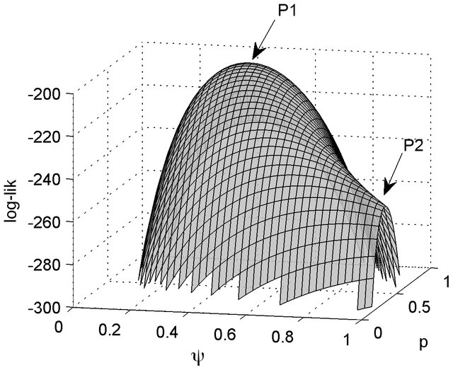
Parameter estimation is an optimization procedure on a likelihood surface

Slide 32
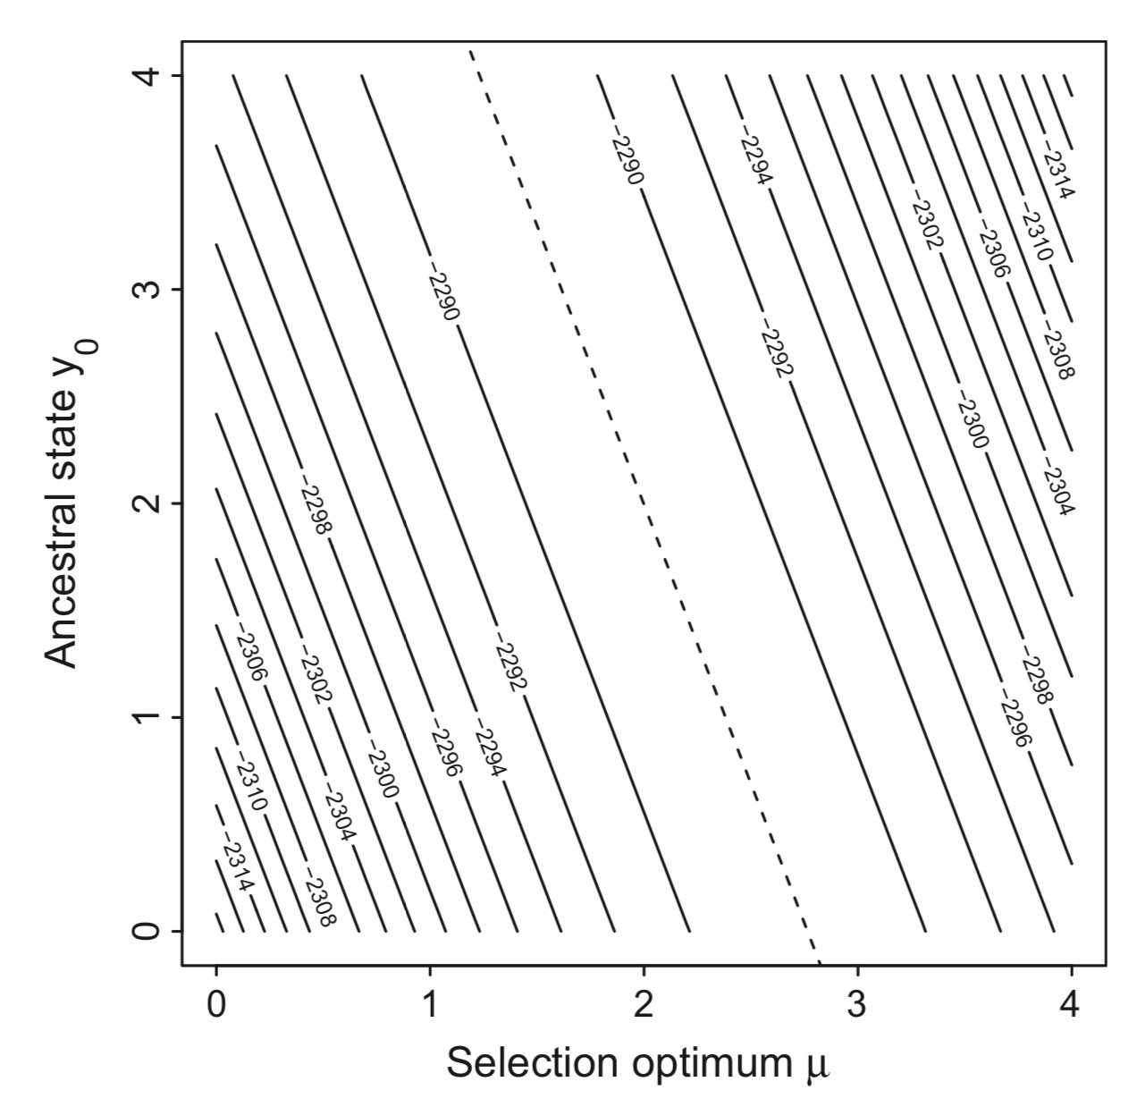
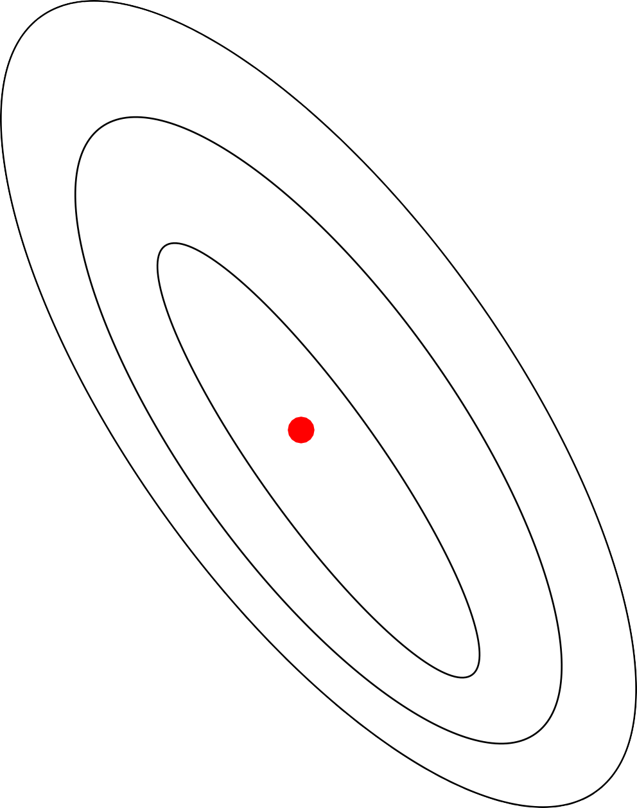
Parameter estimation is an optimization procedure on a likelihood surface

Slide 33
Sub-optimal likelihoods might also be considered “good enough”, specifically 2 log-lik units away from the peak
Parameter estimation is an optimization procedure on a likelihood surface

Slide 34
Sub-optimal likelihoods might also be considered “good enough”, specifically 2 log-lik units away from the peak
Parameter estimation is an optimization procedure on a likelihood surface

Slide 35
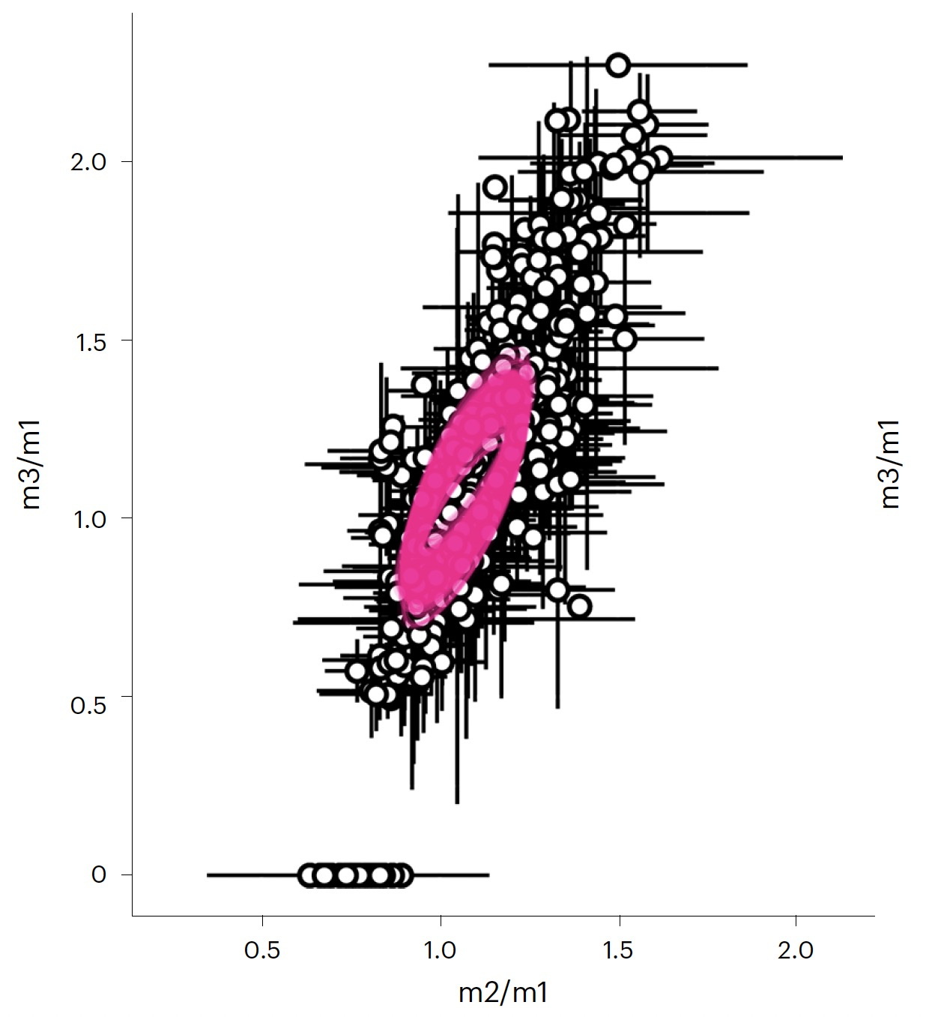
Rate matrix error
Can be done by exploring the likelihood surface
Machado et al. 2023

Slide 36
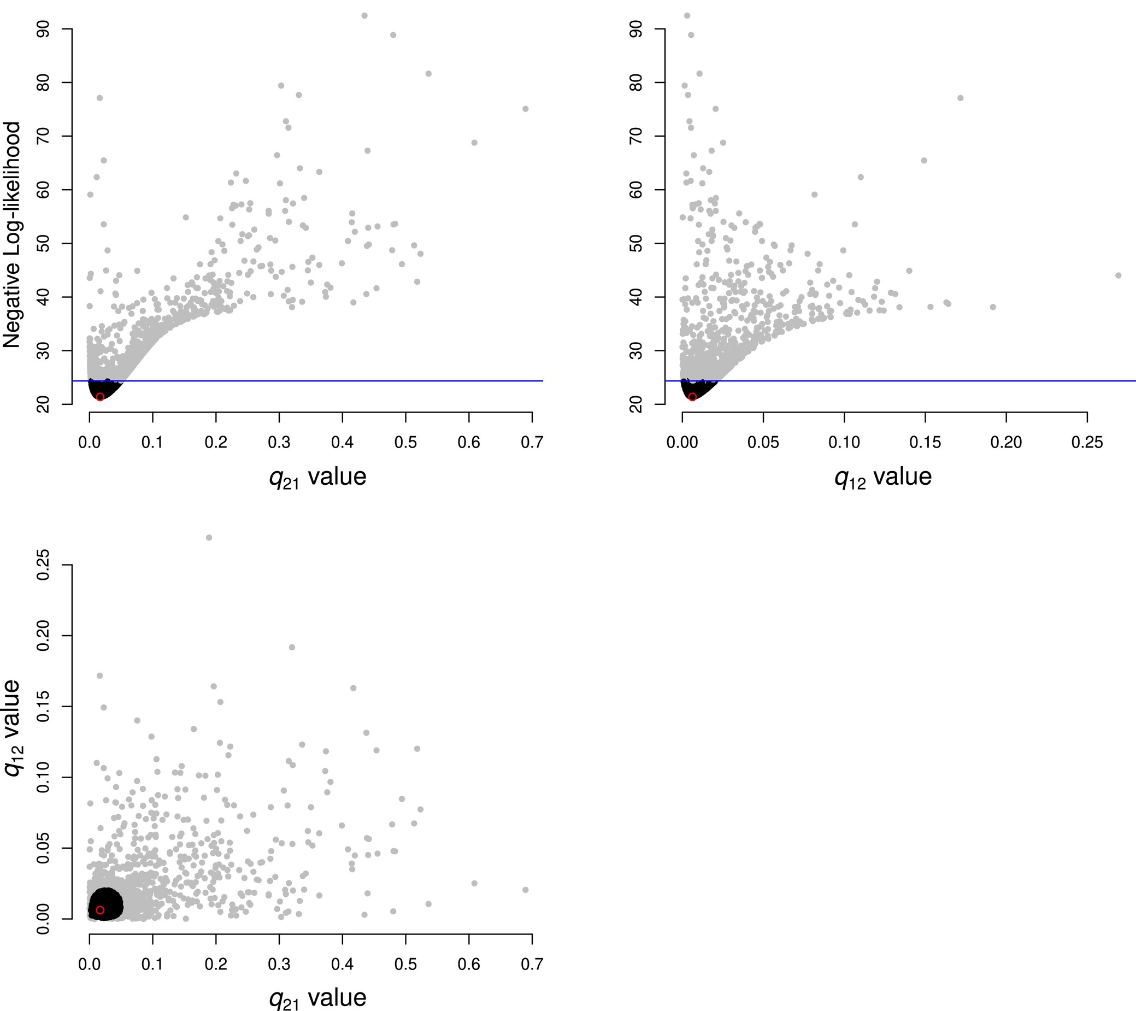
Dentist R package
“Dents” the likelihood surface for a fast exploration of parameter space
Boyko & O’Meara 2024

Slide 37
Lessons
Always account for measurement error
Always account for phylogenetic uncertainty
Always account for parameter estimation error

Slide 38
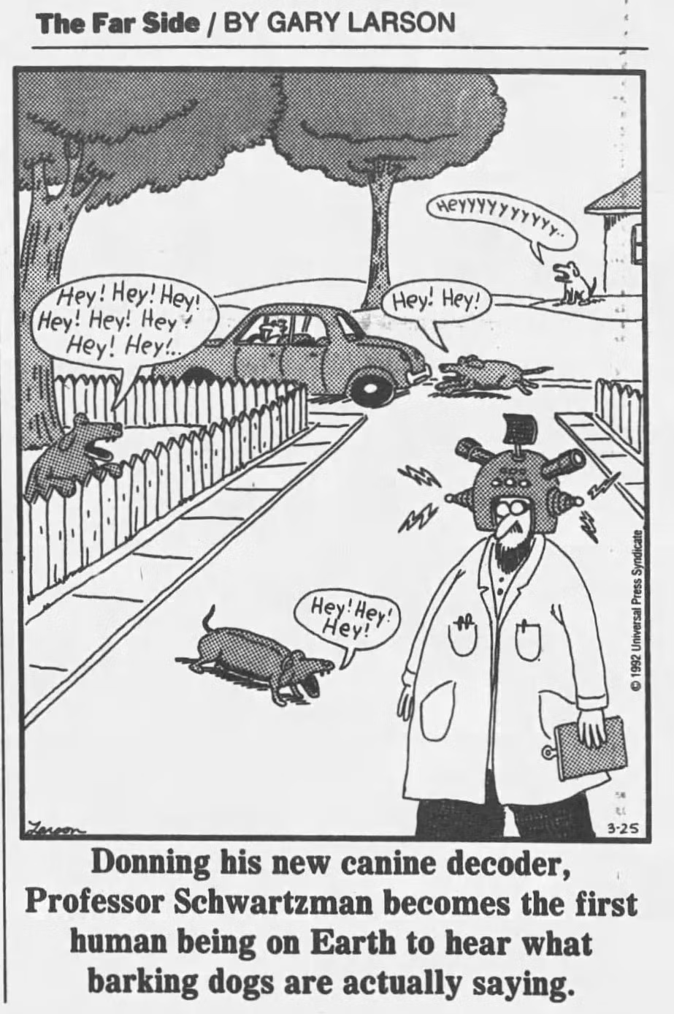
Model Adequacy
Sometimes the best model is not the best model

Slide 39
interpretation
Models
inadequacy
“Estimated data”
(phylogenies)
error/
inadequacy
error
Data
It's possible for the best model is not the best

Slide 40
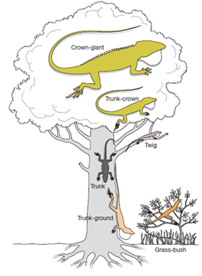
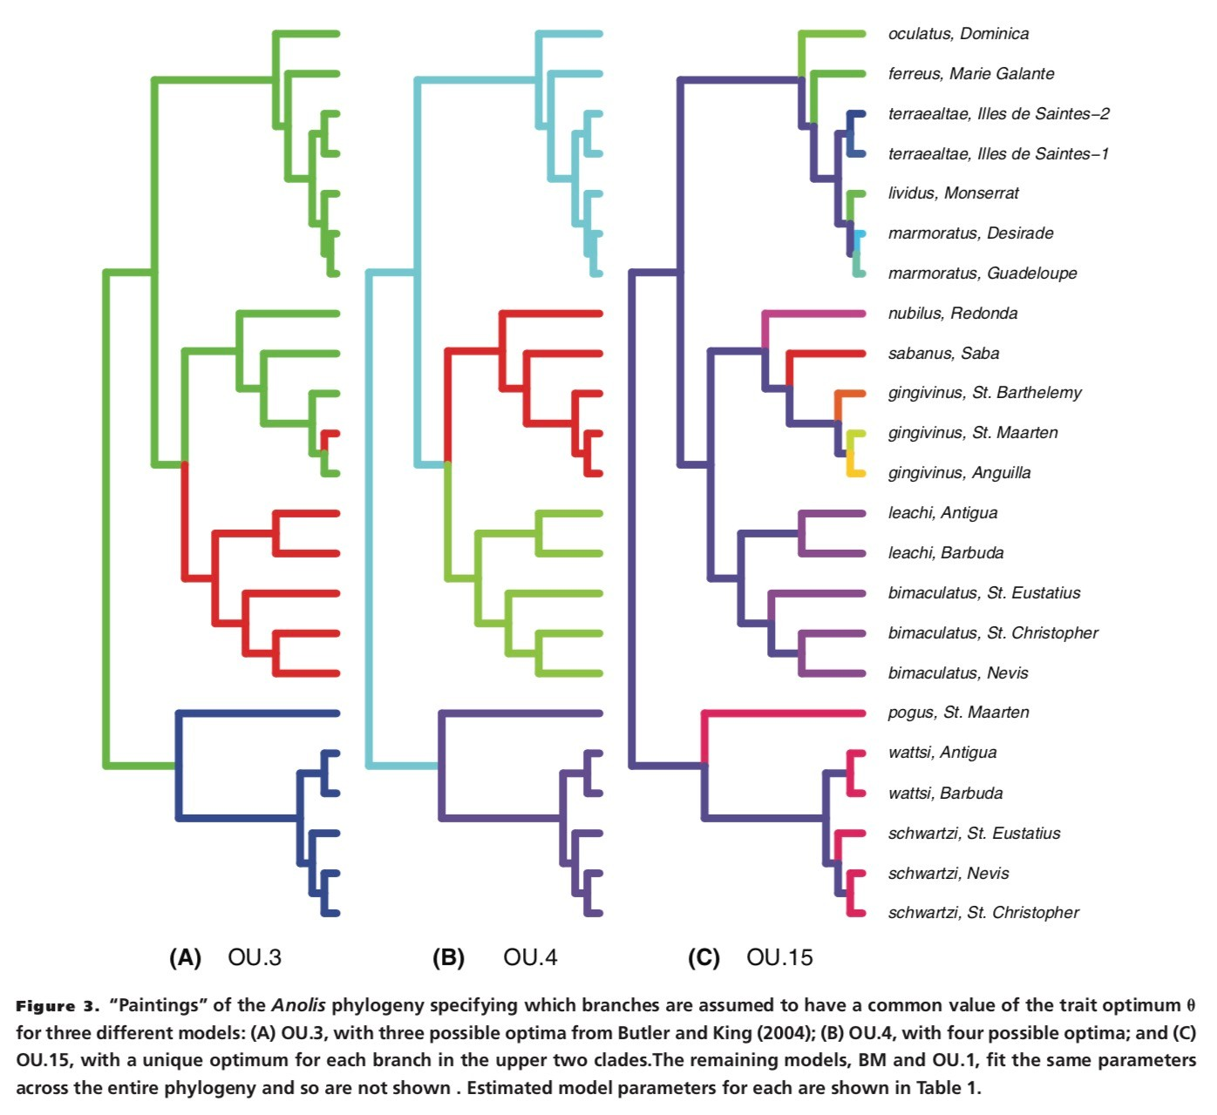
Adaptive radiation of Anoles
z
“Best models” (<2 loglik of best)
How different are they?
Boettiger, Coop, & Ralph 2012

Slide 41
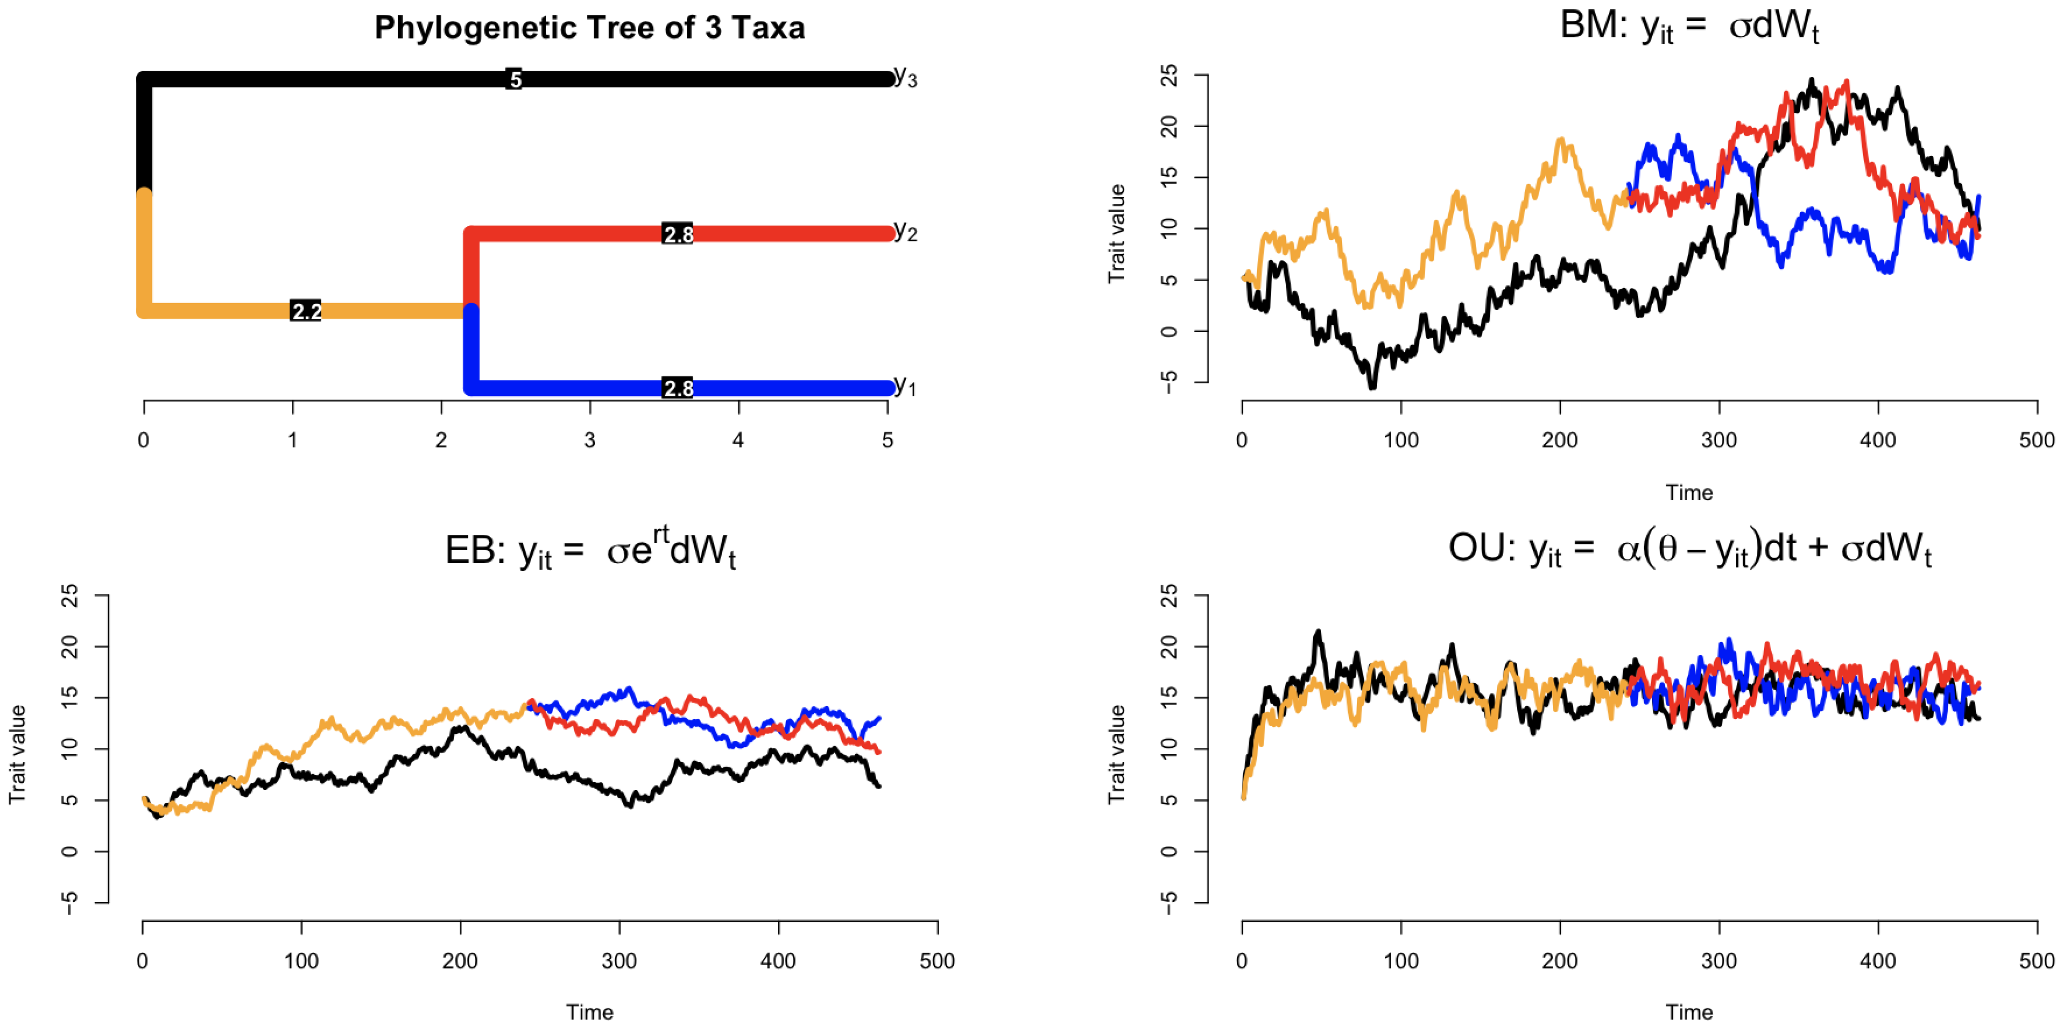
Simulations might help us understand our data

Slide 42
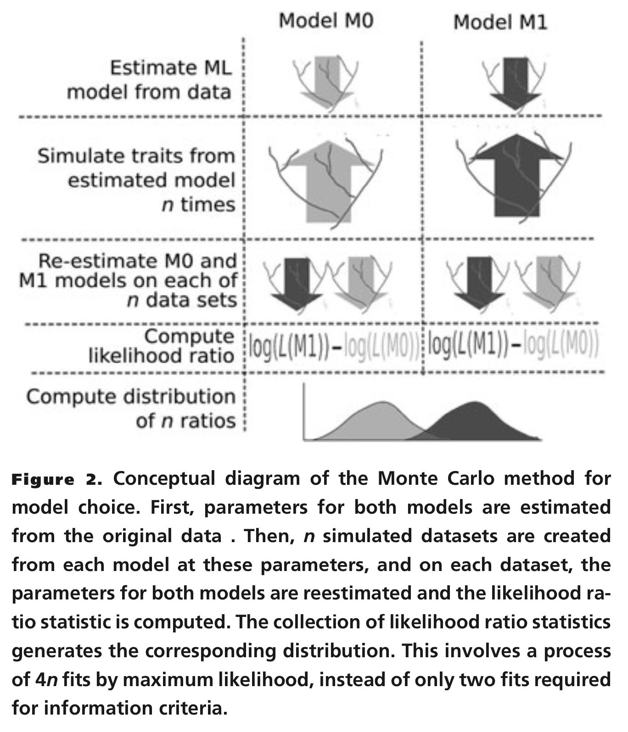
z
Boettiger, Coop, & Ralph 2012

Slide 43
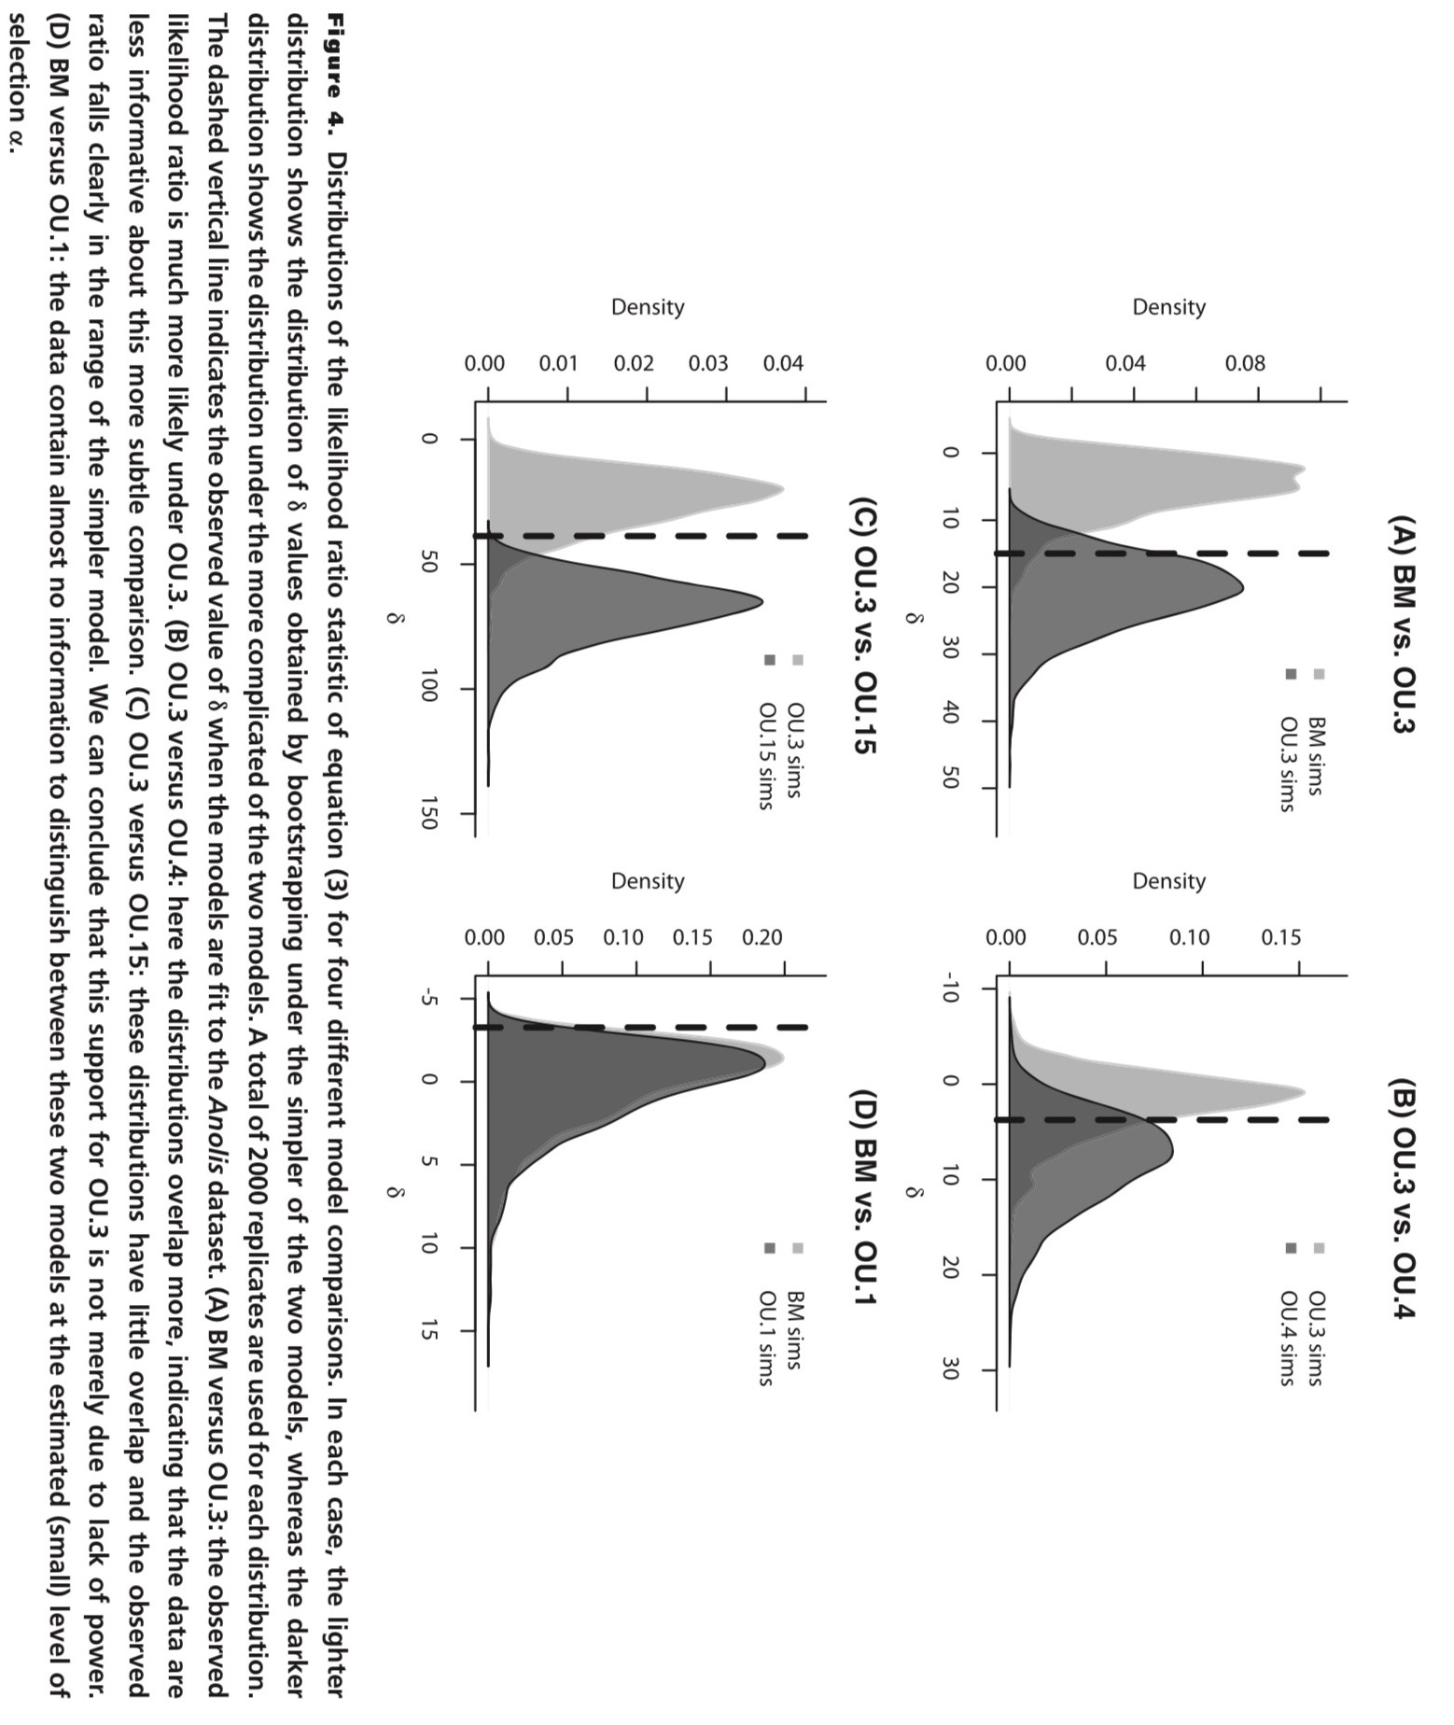
Boettiger, Coop, & Ralph 2012

Slide 44
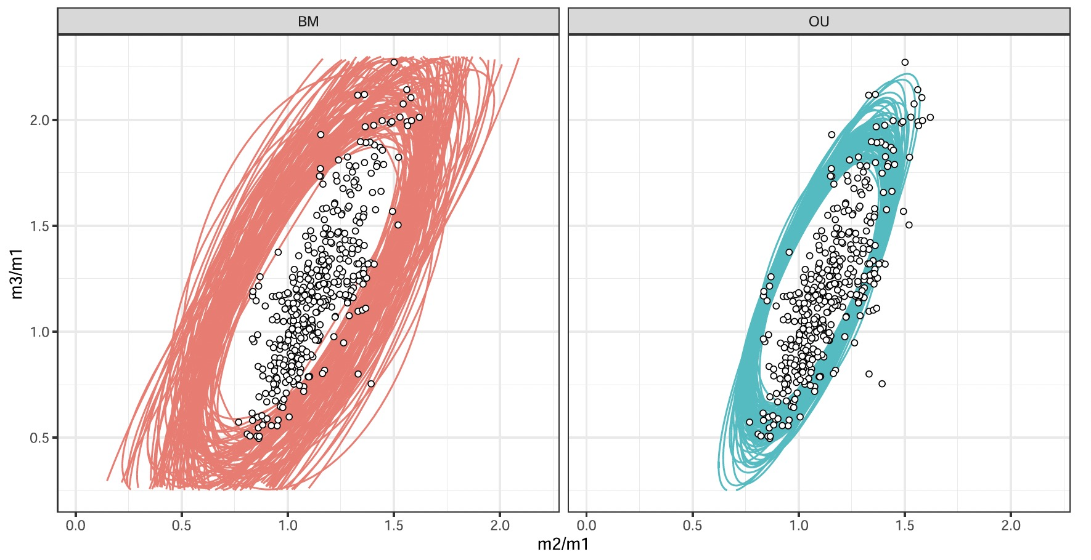
Visual inspection
Bad models will generate data that does not match empirical observations
Machado et al. 2023

Slide 45
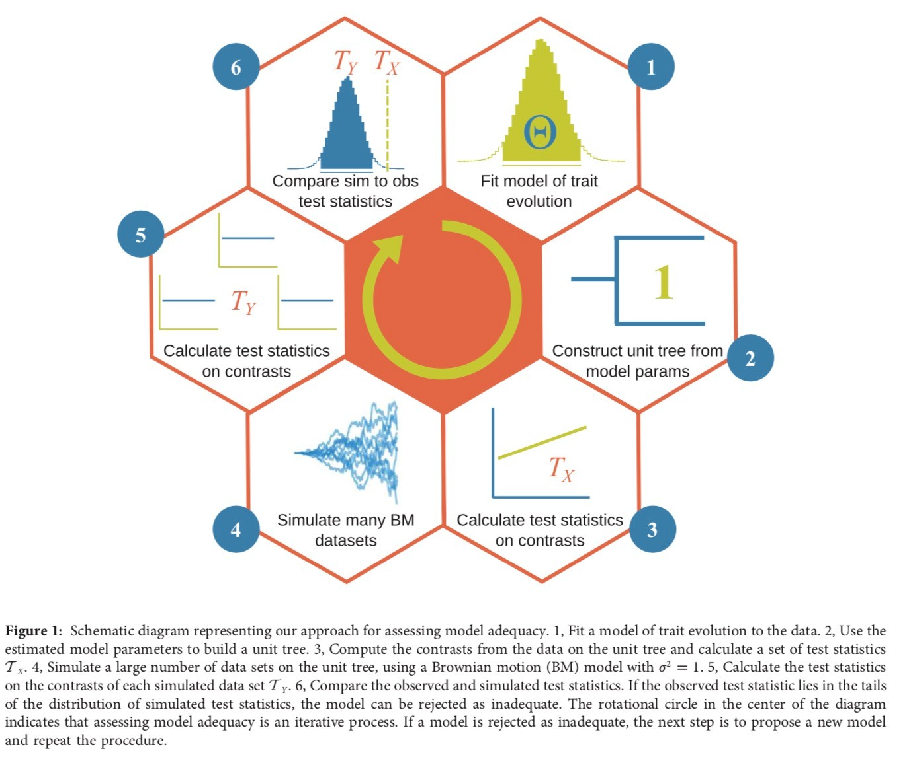
Pennell, FitzJohn, Cornwell, Harmon 2015

Slide 46
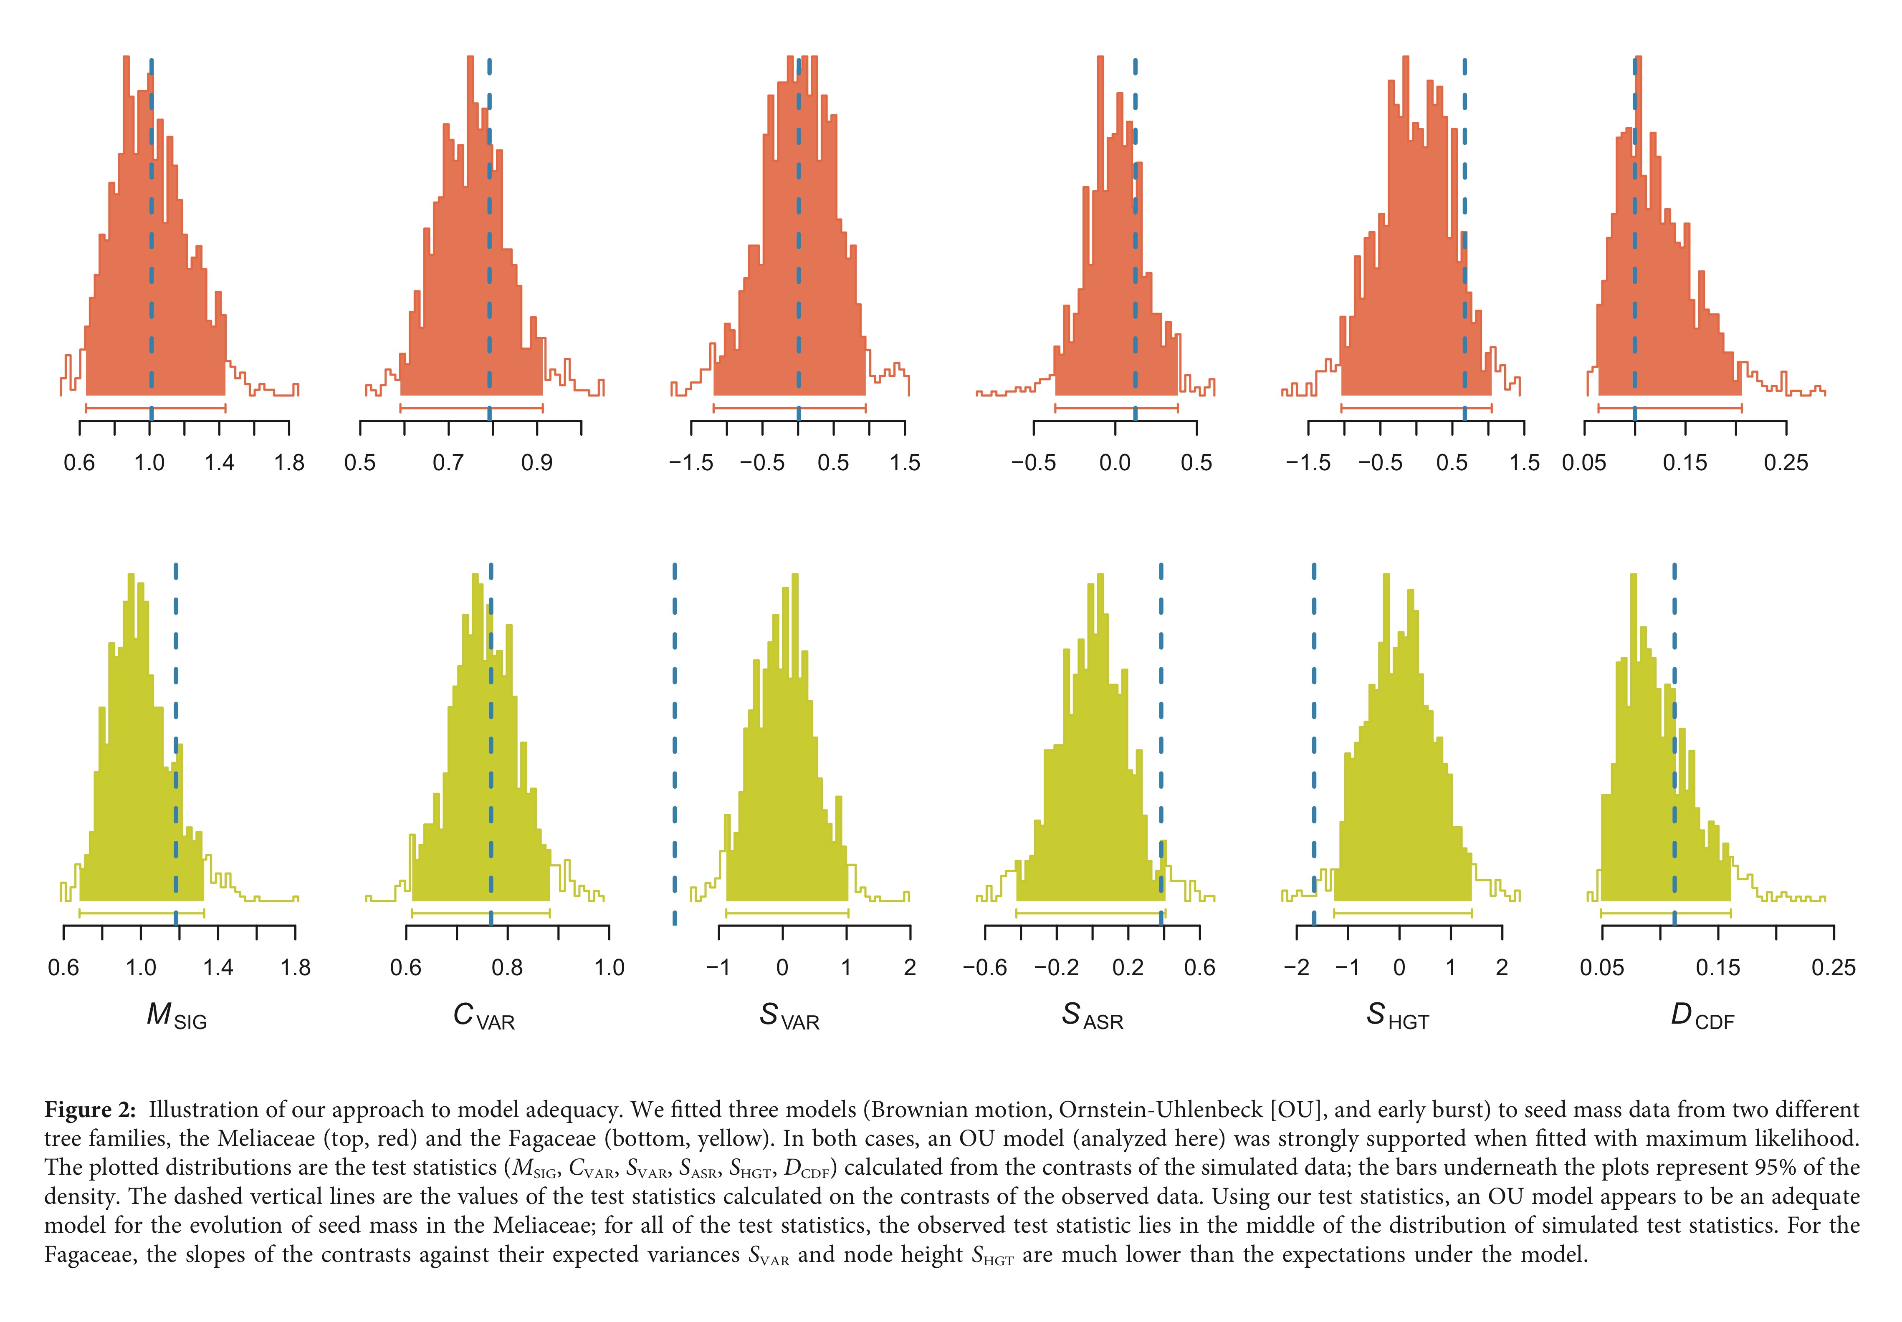
Pennell, FitzJohn, Cornwell, Harmon 2015

Slide 47
Lessons
Always account for measurement error
Always account for phylogenetic uncertainty
Always account for parameter estimation error
Always account for model inadequacy

Slide 48
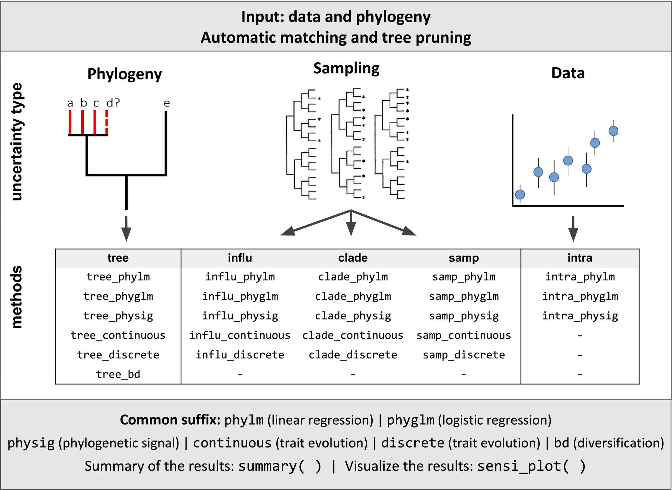
Sensitivity Analysis
Patermo, Penone, Wener, 2018

Slide 49
Identifiability issues
Sometimes model parameters interact with each other

Slide 50
Parameter estimation is an optimization procedure on a likelihood surface

Slide 51
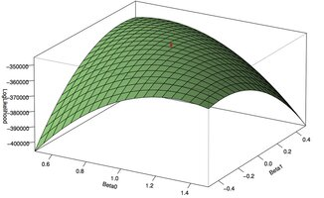
Sometimes likelihood surfaces can be flatter

Slide 52
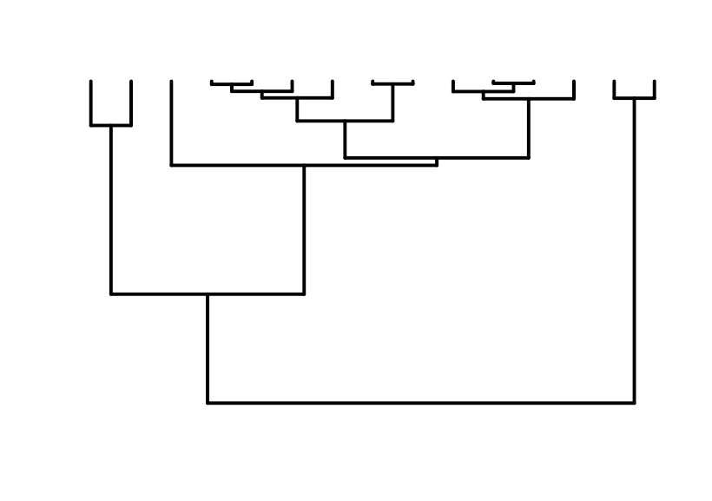
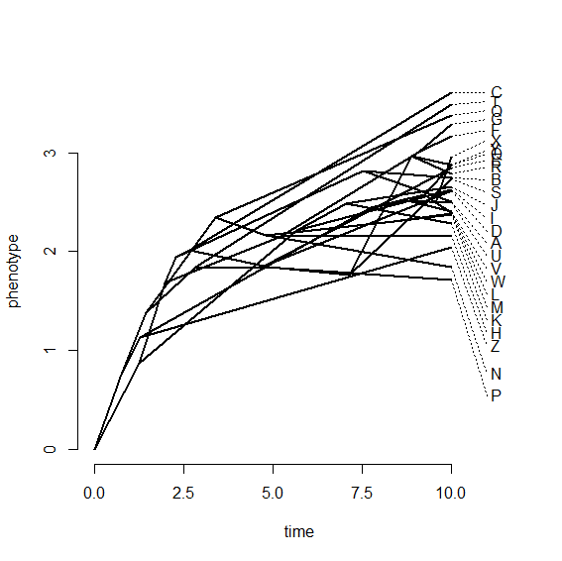
OU: optimum μ ancestral state y0
Ancestral state y₀

Slide 53
This is what we want

Slide 54
This is what we get
Ho and Ané, 2014

Slide 55
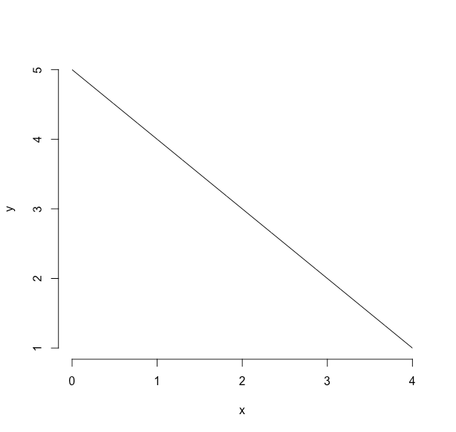
What is x in x+y=5

Slide 56
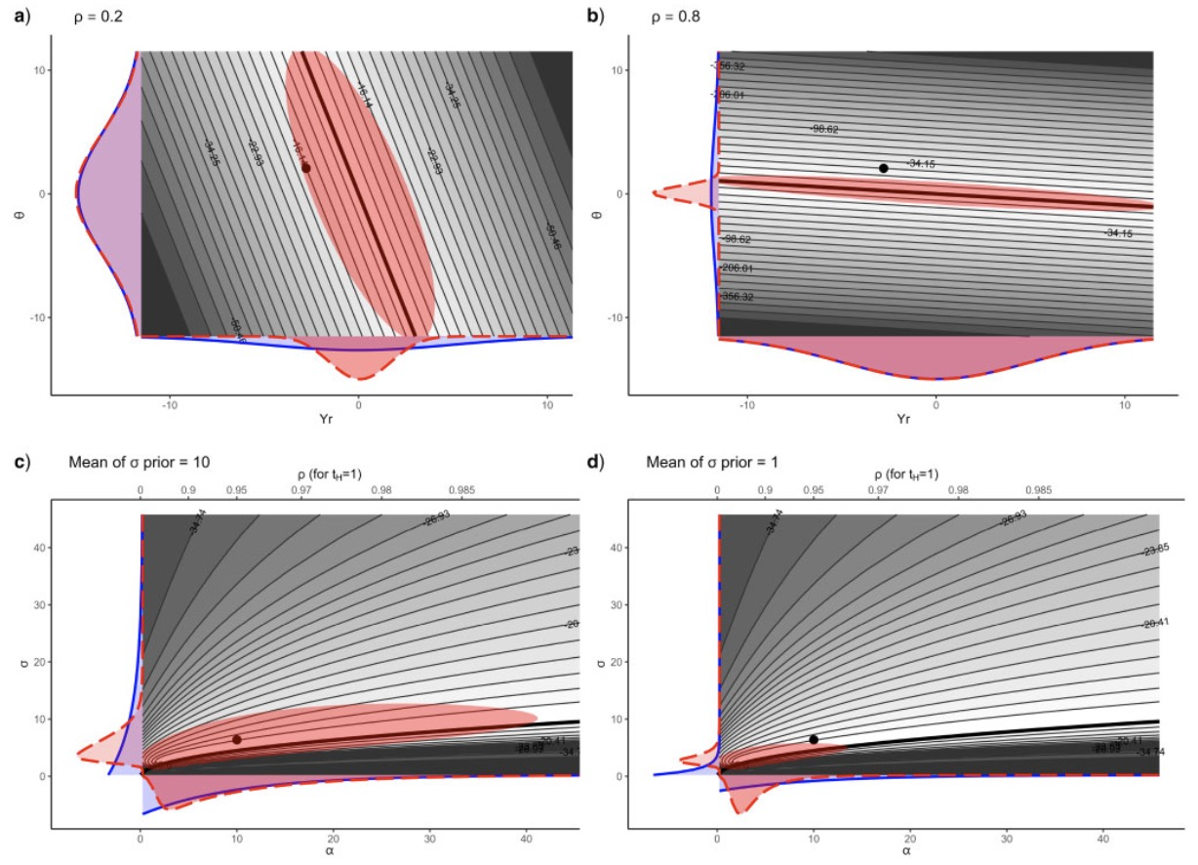
Theta and ancestral state
Alpha and rho
Cornuaut 2014

Slide 57
No information zone
What can we do?

Slide 58
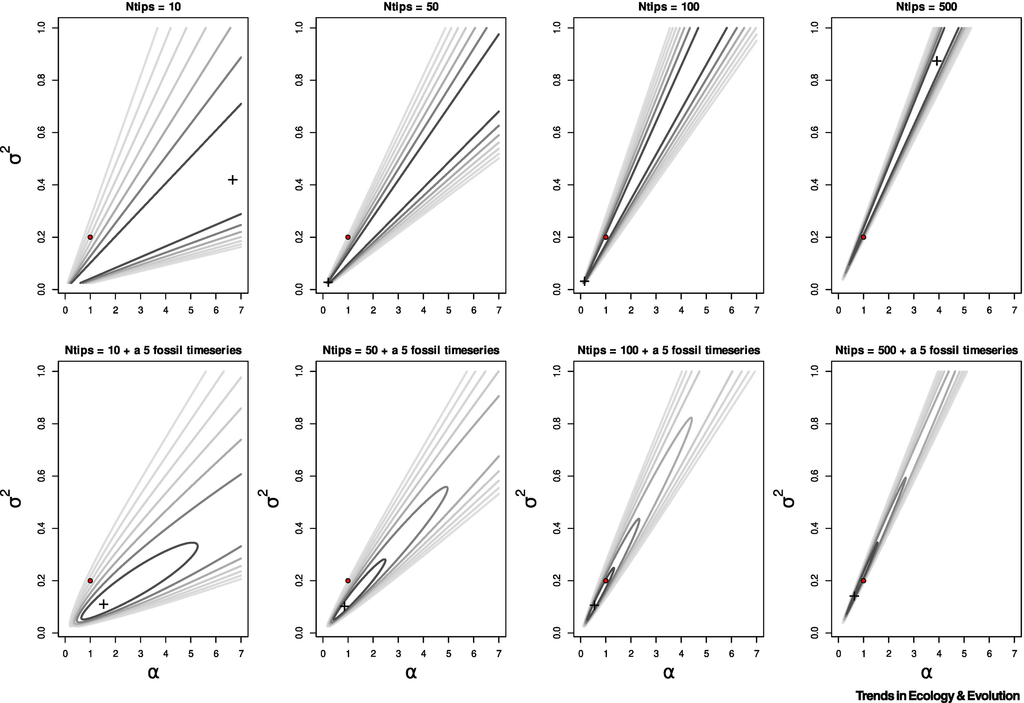
Add tips and fossils
Liow, Uyeda & Hunt, 2023

Slide 59
Lessons
Always account for measurement error
Always account for phylogenetic uncertainty
Always account for parameter estimation error
Always account for model inadequacy
Always account for identifiability issues

Slide 60
Can Rev Bayes save us all?
measurement error
phylogenetic uncertainty
parameter estimation error
model inadequacy
identifiability issues

Slide 61
Can Rev Bayes save us all?
measurement error → not exclusively but yes
phylogenetic uncertainty→
parameter estimation error → yes
model inadequacy → no
identifiability issues → yes with priors

Slide 62
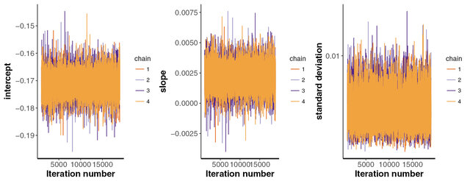
The MCMC machinery can incorporate phylogenetic uncertainty

Slide 63
Can Rev Bayes save us all?
measurement error → not exclusively but yes
phylogenetic uncertainty→ yes
parameter estimation error → yes
model inadequacy → no
identifiability issues → no

